Slide 1
Module 3: Advanced ALP
Dr. P. Nirmala
Assistant Professor (SG – 1)
SENSE, VIT

Slide 2
Interrupt programming using DOS BIOS function calls

Slide 3
What are interrupts?
What would you do when you get a WhatsApp message when you are listening to a lecture?
Which interrupt would you choose?
Knock on the door or a phone call?
Interrupts have priority
Some interrupts are more important than the other

Slide 4
Introduction to interrupts
They cause temporary stop in the execution of the program
When the microprocessor is executing some program, an interrupt breaks the sequence and diverts the sequence to some other program called Interrupt Service Routine (ISR)
Once the ISR is tended to, the control is then returned to the main program

Slide 5
Interrupt sources
Interrupts are needed to connect peripheral devices that have lower data rate than the CPU.
An external signal applied → Hardware interrupt
Interrupt instruction → Software interrupt
Interrupt due to error condition

Slide 6

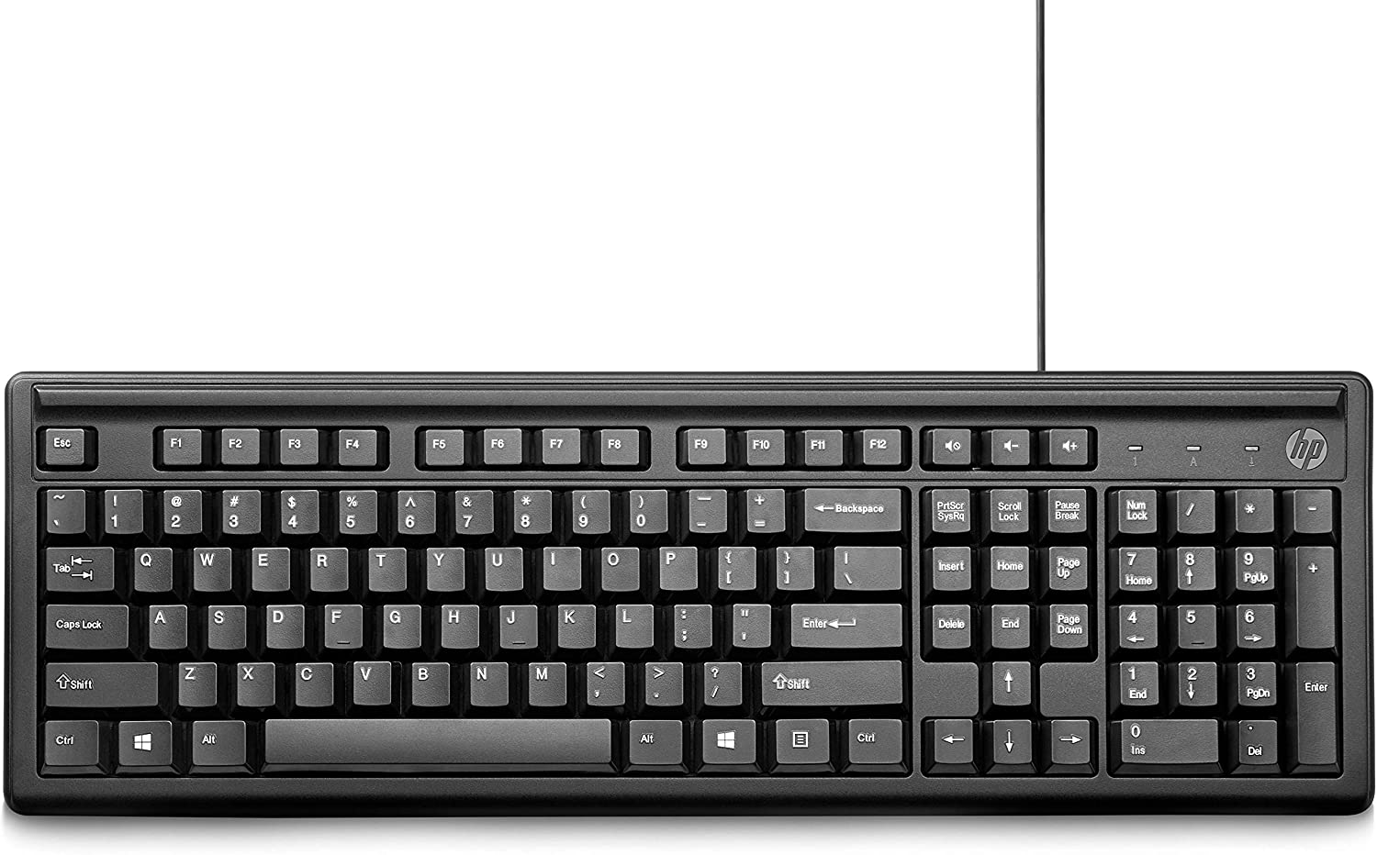
Interrupt Process
Keyboard Controller

Slide 7
DOS and BIOS interrupts
Application program
DOS Support
BIOS Support
I/O peripheral Devices

Slide 8
DOS Interrupts
When MS-DOS is loaded in the computer INT 21H is used to provide an interrupt to perform some important functions.
These are called DOS INT 21H function calls.
Main function calls are data input/output through keyboard
Example:
MOV AH, 01 → to input one character
INT 21H → invoke interrupt

Slide 9
DOS (Disk Operating System) Interrupts
Function Call 01 → Read the keyboard
Input parameter AH = 01 → Read a character from keyboard
Function Call 02 → Display on CRT screen
Input parameter AH = 02 → ASCII character to be displayed in the screen
Function Call 03 → Read character from COM 1

Slide 10
DOS Interrupt continued
Function Call 04 → Write character to COM 1
Function Call 05 → Write to printer attached to Lpt1
Function Call 09 → Display a character string
Function call 0ah → Buffer keyboard input

Slide 11
BIOS Interrupts
The INT 10H subroutines are burned into the ROM BIOS of the 8086 and the compatible hardware and instructions are used to communicate with the user through the screen.
Example → changing colors of characters, background, changing cursor locations, clearing screen.

Slide 12
Difference between DOS and BIOS
BIOS is a firmware that is burnt in ROM and it starts its work on Start up of the processor
It checks whether every hardware connected to the system is proper at the time of booting
For example, it would accommodate date and time settings, keyboard, DVD etc.
It is present in the motherboard of the CPU
DOS is Disk Operating System which is the actual OS present in the hard drive initially.
While starting the computer, the BIOS checks for all the components connected to the computer, and if they are all fine, then it would make the OS get loaded in RAM for starting it.

Slide 13
BIOS (Basic Input/Output System) Interrupts
Function Call 00 – Select Video mode
Here Al → mode Number, Ah = 00
Al = 00 → 40 x 25 black and white
Al = 04 → 320 x 200 colour
Al = 10H → 640 x 350 x 16 colour
Function call 03 → Read cursor position
Ah = 03, Bh = Page number (Input Parameters)

Slide 14
BIOS Interrupts Continued
Function call 0E → Write character on CRT screen and advance cursor
INT 11H → Determine the type of equipment installed
INT 14H → To control the serial communication port attached to the computer
INT 16H → Keyboard interrupt

Slide 15
Weblinks
http://www.ablmcc.edu.hk/~scy/CIT/8086_bios_and_dos_interrupts.htm
https://www.slideshare.net/VijayKumar486/8086-interrupts-with-dos-and-bios-by-vijay/60
http://www.ece.lsu.edu/desouza/Classes/EE3751/Lab%203.pdf
http://faculty.uml.edu/yluo/teaching/microprocessorii/resources/interrupts.pdf

